Slide 1

DriverPass
System Analysis
Mohamed F. El-Hewie
Notes:
Title: DriverPass System Analysis
Subtitle: Project Overview and Architecture
Content:
Introduction to DriverPass software
System goals and user workflows

Slide 2

System Requirements
Nonfunctional Requirements:
  Built as a cloud-hosted web application
  Fully responsive and optimized for cross-browser use
Functional Requirements:
  Authenticates user login credentials.
  Displays details of services available for purchase.
Notes:
Speaker notes:
Welcome, everyone.
Today we are sharing our plan for a new online training platform that runs entirely on the internet, meaning you do not need special computers or local setups to use it.
You can open it smoothly on any popular web browser like Chrome, Firefox, Safari, or Edge, and it will look and work great whether you use a computer, tablet, or phone.
For your safety, the system uses secure logins, lets you reset your password safely through your email, and locks temporarily if someone tries to guess your password too many times.
Inside the platform, you can easily view available training packages, buy new ones, change or cancel your choices, and trust that your personal information is stored safely behind the scenes.

Slide 3
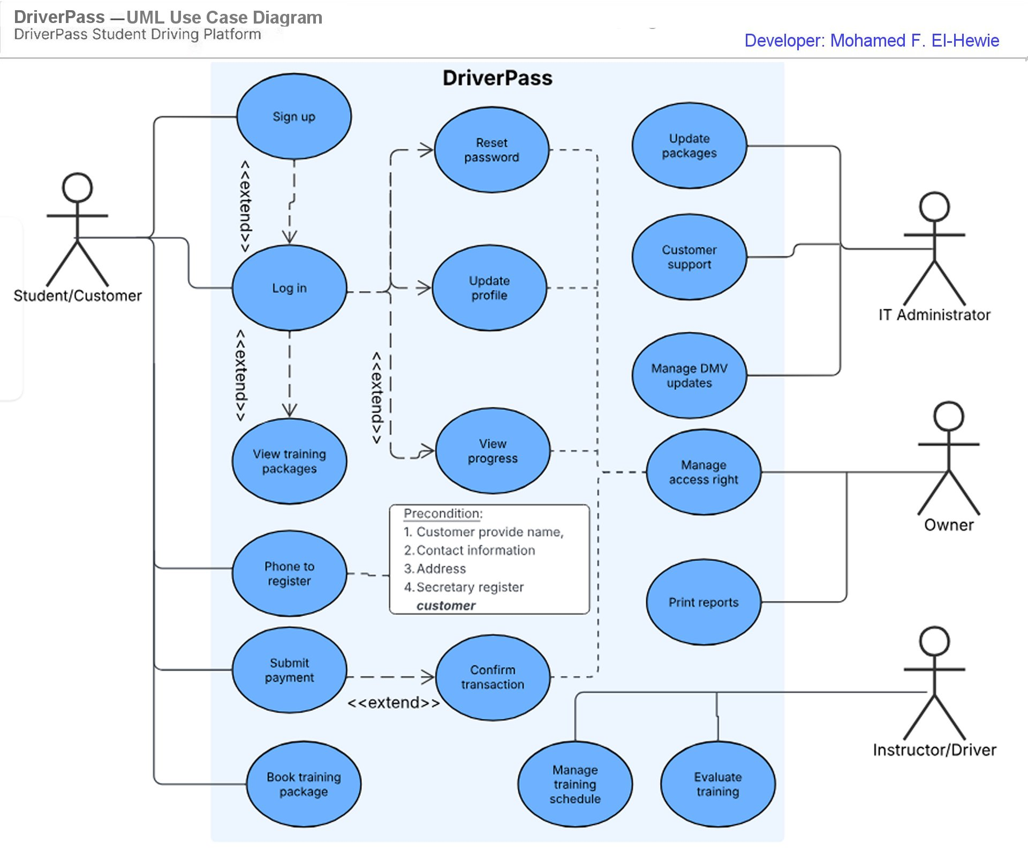
Use Case Diagram
Notes:
Speaker notes:
Welcome everyone.
Our new system, shown as a large sky-blue box, connects four main people to the software using simple lines.
First, customers start by logging in to book training, pay fees, read materials, and check their progress.
Second, the IT staff helps users, updates training packages, and keeps the system running smoothly.
Third, driving instructors set the calendar, grade students, and write daily feedback notes.
Finally, Liam, the owner, holds top control to manage team access and view big-picture business reports.
While our secretary helps out, the system handles that role internally.
To support DriverPass and its users, we designed these clear steps so everyone can do their daily tasks quickly and safely.

Slide 4
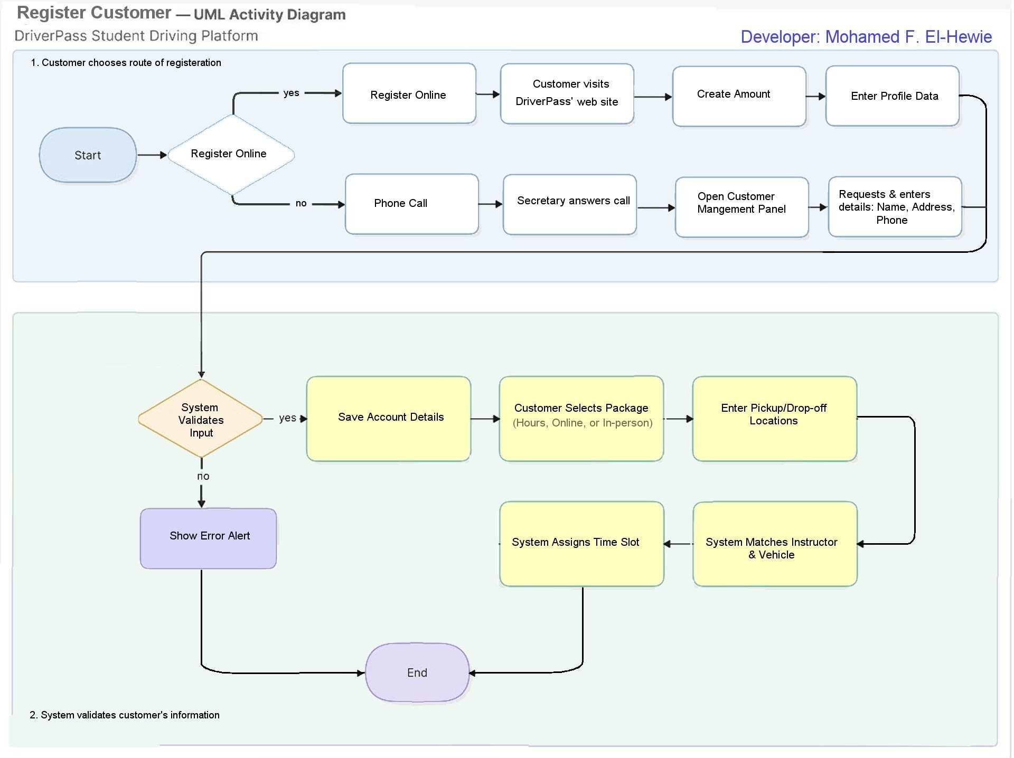
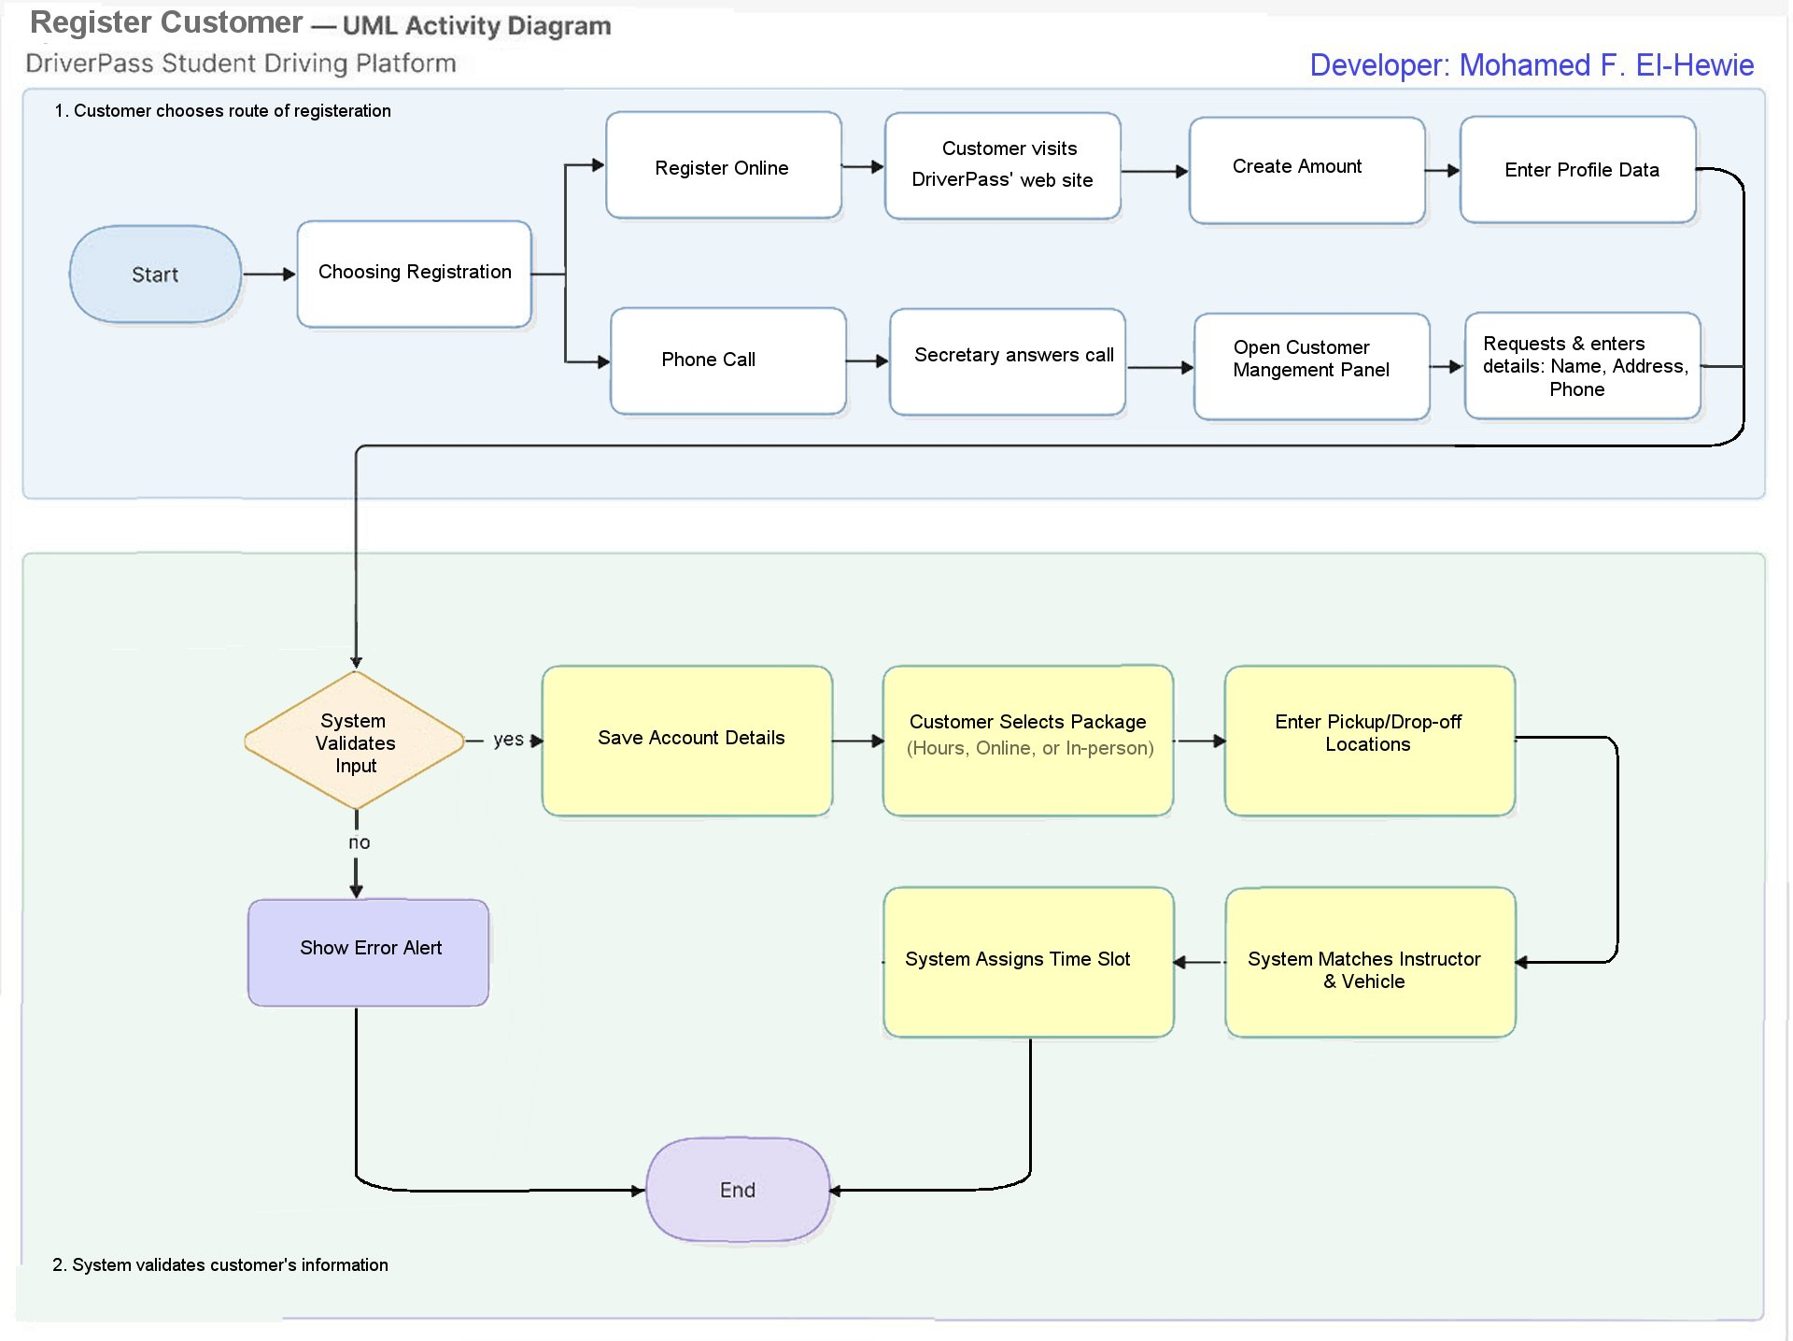
Activity
Diagram
Notes:
Speaker notes:
We begin our journey at the solid start circle, where users choose to sign up either online or through a phone call with a secretary.
The diamond decision shapes guide us to check if the typed details are correct, bringing both paths together at a single meeting point.
After checking the info, the system quietly saves the exact time and user ID for the manager reports.
Next, the system matches your new profile with the right cars and teachers for your times.
Finally, we reach the end target symbol, showing your account is ready and your schedule is set.

Slide 5
Security
Authentication: Requires unique identifiers for users
Data Protection: Secures data during exchange and storage.
Threat Mitigates: Stops brute-force and automated bot attacks.
Recovery: Manages account recovery via strict workflow.
Notes:
Speaker notes:
To ensure our platform is both welcoming and highly secure, we have built a multi-layered defense system that protects our users without disrupting their experience.
First, our check-in process requires a clear, unique identifier—like an email or phone number—backed by strong proof of identity, such as a secure password or a temporary code.
Once a user is in, we shield their personal information both when it travels across the internet and when it rests safely on our servers, transforming sensitive details into scrambled, unreadable formats that outsiders cannot crack.
We also keep a watchful eye out for automated bad actors;
if we notice too many rapid-fire login attempts from a single location, our system automatically steps in to limit access and intentionally slows down after repeated mistakes to exhaust any automated guesswork.
Finally, if someone genuinely loses access, we guide them through a tightly controlled, step-by-step identity verification process to safely reset their credentials and regain entry.

Slide 6
System Limitations
Connectivity: Automated Internet updates require persistent active connection.
Frequent Updates Needed: External interfaces require regular updates
Capped Physical Resources: Limited scheduling and routing capabilities.
Rigid Waterfall Model: Limits the ability to adapt to changing user needs.
Uncapped Budgetary Expenses: Undefined budgetary caps on cloud application or third-party API operational expenses.
External Variables: User digital literacy levels, offline capabilities, environmental conditions.
Notes:
Speaker notes:
Our system has a few important limits to keep in mind.
The software needs a steady internet link for updates and DMV data checks, which can cause slight pauses during use.
We also depend on outside groups like the DMV, meaning we must update our app often when web standards or rules change.
Right now, the platform can only handle up to ten vehicles or drivers at a time.
Because we built this using a strict 15-week plan, we cannot easily change things if we misunderstood early goals.
We also do not have a set budget for ongoing cloud and outside service costs.
Finally, the design does not fully account for offline use, bad weather, changing rules, or users who might struggle with digital tools.

